Slide 1

CAN SYSTEM WALKTHROUGH
Sajib Sen
1

Slide 2
Features:
Insert
Delete
Stop
LoopUp

Slide 3
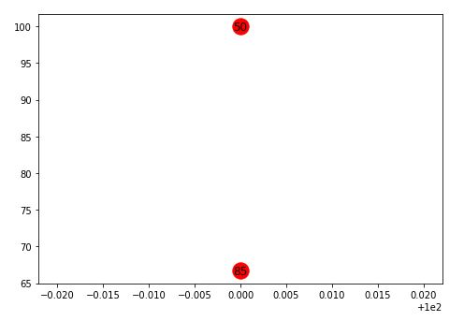
Features:
Insert
Example: For visualization I converted the scale from 0-1multiplying 100 to 0-100.
Select the operation: (1) insert (2) delete (3) stop: 1

Slide 4
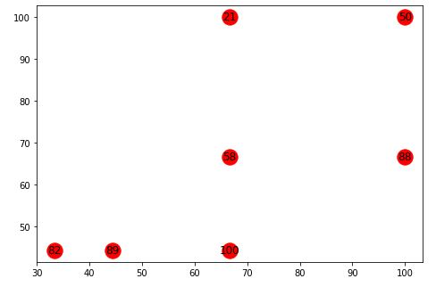
Features:
Insert
Example: After inserting some nodes to CAN

Slide 5
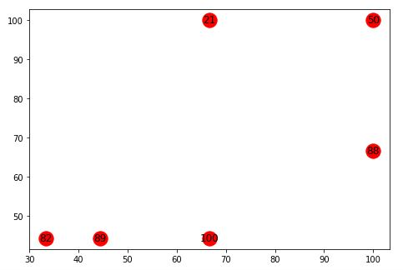
Features:
2. Delete
Example:
Select the operation: (1) insert (2) delete (3) stop: 2
choose the node to delete: 58

Slide 6
Features:
3. Stop
By using stop function you are not allowed to modify your CAN system. You will be prompted for lookup operation
Example:
Select the operation: (1) insert (2) delete (3) stop: 3
Lookup Operation: Choose two points in your CAN to find the basic route:

Slide 7
Features:
4. LookUp
Example:
Lookup Operation: Choose two points in your CAN to find the basic route:
Provide start node: 50
Provide destination node: 82
Source to Destination path: 50 =>88 88 =>82

Slide 8
Thanks

